Slide 1

SUPERMARKET BILLING SYSTEM
JAVA PROGRAM

Slide 2
PURPOSE OF CODE ?
Creating a complete supermarket billing system involves multiple components such as managing products, customers, transactions, and generating bills. Here, I'll provide you with a simplified Java code outline that focuses on the core functionalities of a supermarket billing system. This example will cover basic operations such as adding products, calculating bills, and displaying them. Note that a real-world application would require more robust error handling, database integration, and possibly a GUI for better user interaction.

Slide 3

PROGRAM:
https://docs.google.com/document/d/e/2PACX-1vQbm5-RApUmiACgxYCn53YgbeIWOIXVrjByLd2lhzSDM2nCIBLNJgIJeDLu7WWMXPMOdC8StVuoNh3A/pub

Slide 4
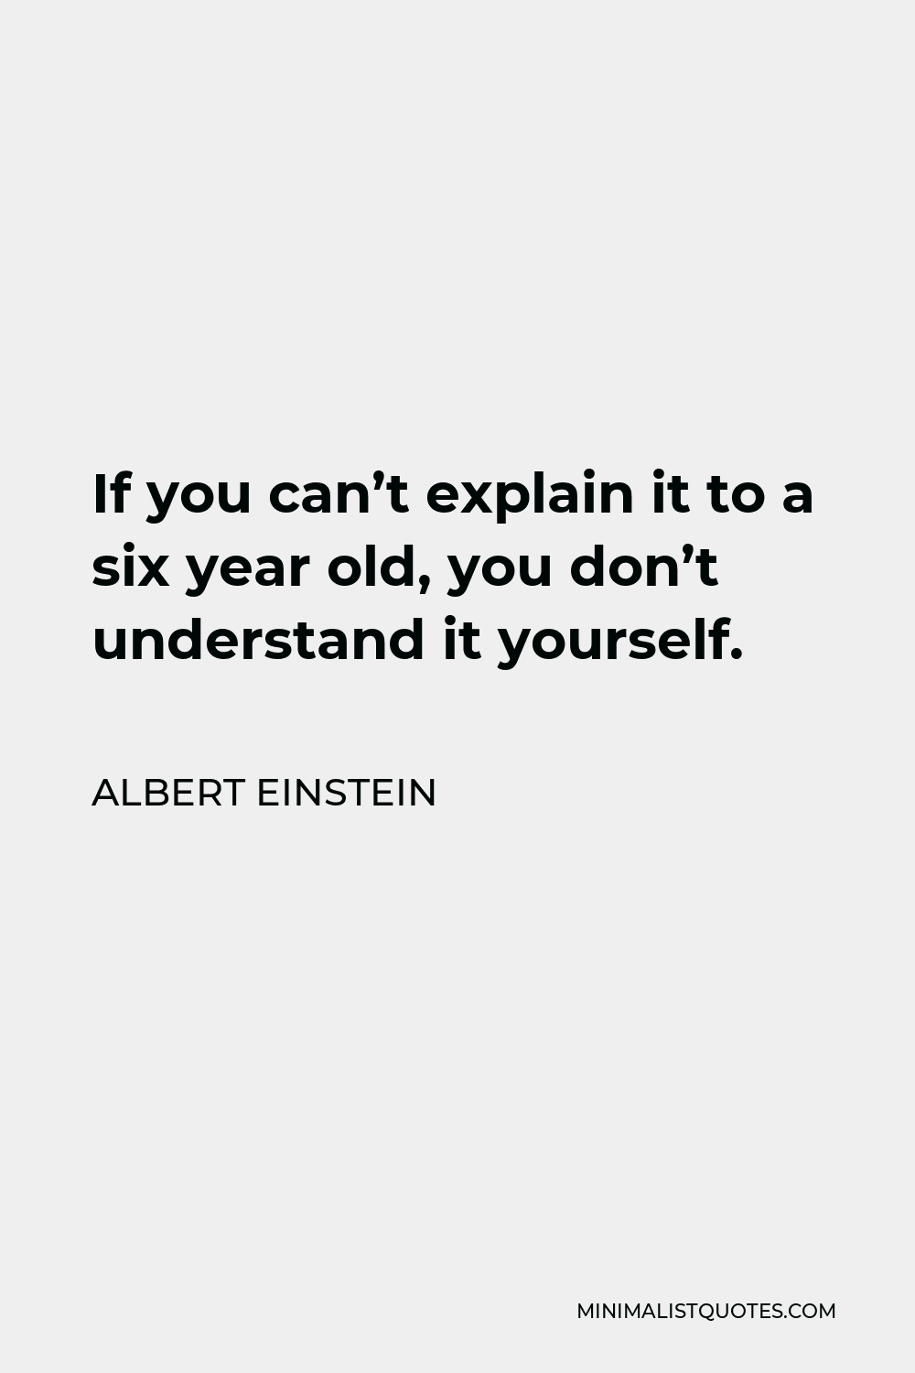
CODE EXPLANATION:
Product Class: Represents each product with attributes like name, price, and quantity.
Supermarket Class: Manages a list of products and provides methods to add products to the inventory and generate bills.
Main Class: Demonstrates how to use the ‘Supermarket’ class by adding products to the
inventory , creating a shopping cart(“cart”),and generating a bill.

Slide 5
USAGE OF CODE:
//The ‘supermarket’ class provides methods (‘add Product’ and ‘generate Bill’) interact with the supermarket’s inventory And billing system.
// Modify and expand upon these classes based on your specific requirements. For example, you
could add methods for removing products, updating quantities, handling discounts, integrating with
database, or creating a graphical user interface (GUI).
This example provides a foundational structure. Depending on your project's requirements, you may need to extend this code to include additional features and functionality.

Slide 6
EXPLANATION OF OUTPUT:
The ‘supermarket’ class calculates the total cost for each item based on its price and quantity in the shopping cart(“cart”).
It then prints a formatted bill with columns for the product name, price per unit, quantity purchased, and total cost for each product.
Finally, it displays the total bill amount at the bottom.

Slide 7

TEAM MEMBERS:
DHANUSH G N – AA1-09
HARISH S – AA1-11
DHANESH KUMAR S – AA1-22
SRIRAM S – AA1-36
MUHAMMAD IMRAN M - AA1-21

